Slide 1
BUILDING EFFECTIVE REFORM TEAMS with LEADERSHIP FOR RESULTS – L4R
Frankfurt, March 4th, 2014
Benjamina Randrianarivelo
World Bank Institute
Operations Officer
Leadership & Governance
(WBILG)
1

Slide 2
“… Une cellule de concertation Gouvernement – Secteur Privé est restée en léthargie totale depuis 2001 …”
“… A Government - Private Sector consultation committee remained in total lethargy since 2001 …”

Slide 3
This is not an isolated case. Why?
Lack of structured coalitions & teams
Lack of mechanisms for implementing
No mechanisms for sustaining partnership
Lack of organization (PS)
Lack of capacity (incl. continual change; no commitment)
Lack of mutual trust
Weak coordination and/or follow up
Notes:
Typical issues:
Lack of mechanisms for implementing joint agendas
People concerned by recommendations not committed in implementing those action plans
Weak coordination between the different actors and stakeholders (institutions, individuals)
Planning without milestones or progress markers
Lack of follow-up on the implementation
Lack of organization at the level of private sector
No mechanisms for sustaining partnership

Slide 4
One way HOW to address those issues: L4R
Leadership for Results

Slide 5
Successful implementation through effective reform coalitions
Authorizing Environment
Change process coaching
Structured approach and tools
Team or Coalition functioning
KEY CONCEPTS OF L4R

Slide 6
Set up an authorizing environment
Key actions
Tools
Buy-in and readiness for moving ahead
Inspiring values & trust
Commitment to supporting implementation teams
Institutionalizing effective practices experimented by teams
Adaptive leadership
Visioning
Strategic evidence-based monitoring
Performance & Strategy
Strategic Communication based on Vision + Results
Progressive alliance building (Incentives + Opportunities)

Slide 7
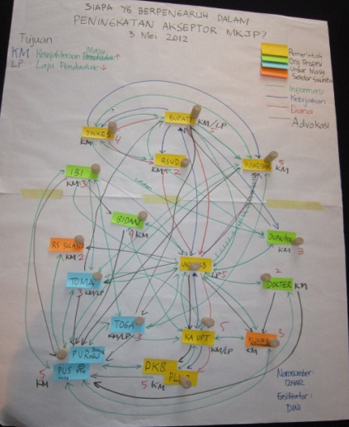
Enhance Team and/or Coalition functioning
Tools
Key actions
Net-Map
Tool helping teams better understand the stakeholder networks that influence their success:
Who is involved?
What are their formal and informal links?
What do they want?
How influential are they?
What can we use this information?
Identifying people concerned by the challenges
Bringing them in an organized fashion
Roles and responsibility
Accountability for actions and results
…
Notes:
Identifying people concerned by the challenges
Bringing them together to work towards shared goals in an organized fashion
Making team members accountable for their actions and results
Clarifying roles and responsibility for deliverables

Slide 8
Coach teams and authorizers through change process
Key actions
Tools
Catalyzing and accompanying stakeholders and teams in:
Formulating priorities
Identifying critical issues
Clarifying challenges
Producing short term outcomes
Articulating them within a broader reform agenda
WBI Certification program:
NetMap,
RRI
Regional Coach networks (NetMap, RRI, StratComm)
Internal coaches: embedded in local institutions

Slide 9
Apply structured approach & tools
Key actions
Facilitating the process
Empowering individuals and teams
Providing tools based on proven practices
Capitalizing on lessons learnt (reasons for success/failures)
…
Tools
RRI
A disciplined process through which a team develops the skills and confidence needed to achieve ‘stretch’ results, through experimentation and learning, in 100 days or less.
Results first
Temporary structure
Learning all along the way
Instutionalize effective practice – Scale up
Reduce delays in connecting electricity from 3 months to 1 week in 100 days starting 1 Sept. 2013
Notes:
stakeholder mapping,
effective facilitation,
team dynamics,
coalition building,
work plan development,
follow-up and monitoring…

Slide 10
Examples of pratictioners of L4R/RRI

Slide 11
Example of Sectors
Urban
settlement
Land administration
Solid waste management
Water and Sewerage management
Public Sector Capacity Building
Connection to Electricity
Local tax collection
Civil service HR management
Education
Financial Management Information Systems
Pharmaceutical procurement

Slide 12
For more information, please contact: Benjamina M. RANDRIANARIVELO brandrianarivelo@worldbank.org

